Slide 1
Lecture # 13-14
Dr. M. Nadeem

Slide 2
Stacks
A stack is a linear list in which insertion and deletion operations are performed at only one end of the list.
Thus you are able to insert as well as delete the element from only one end of the stack.
Since insertion and deletion operations are performed at same end, the element which is inserted Last is first to delete.
A deck of cards or a pile of plates
A real-world stack allows operations at one end only.
Notes:
A stack is a data structure that stores and retrieves items in a last-in
first-out manner (LIFO).

Slide 3
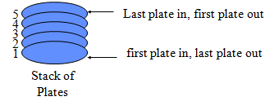
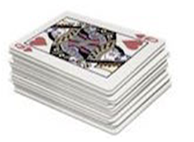
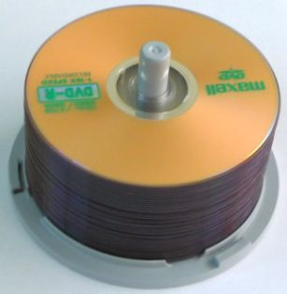

Stacks
For example, we can place or remove a card or plates on a shelf from the top of the stack only
At any given time, we can only access the top element of a stack.
Stack of CD’s
Stack of Books
Notes:
Clean Dish Example

Slide 4
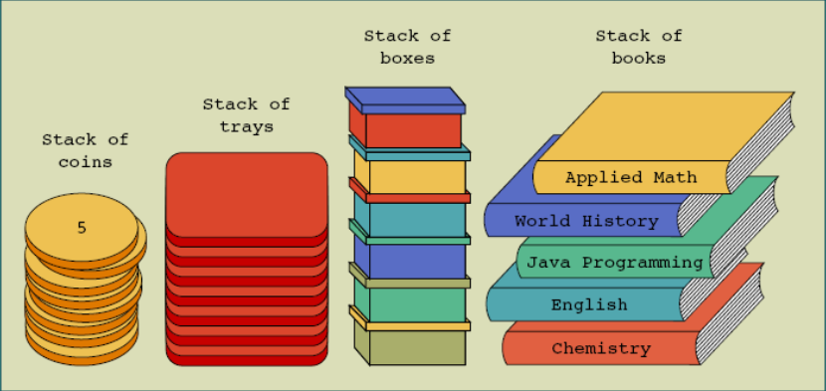
Conceptual Stacks

Slide 5
Stacks
Consider a card game with a discard pile
Discards always placed on the top of the pile
Players may retrieve a card only from the top
LIFO stands for Last-in-first-out. Here, the element which is placed (inserted or added) last, is accessed first. In stack terminology, insertion operation is called PUSH operation and removal operation is called POP operation.

Slide 6
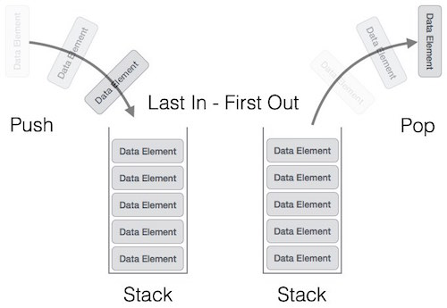
Stack Representation

Slide 7
Stacks
Consider a stack of plates at dinner counter.
The person who comes for dinner takes off the plate which is at top of the stack.
After washing the plates the waiter places the washed plates on the top of the stack.
So the plate that is placed last is first take by person.

Slide 8
Applications of stack
Stacks are useful data structures for algorithms that work first with the last saved element of a series.
e.g. computer systems use stack while executing programs, when a function is called, its return address goes on a stack.
Evaluation of arithmetic expressions by compilers [infix to postfix conversion, infix to prefix conversion, evaluation of postfix expressions]
Auxiliary data structure for some algorithms
Example: Converting a decimal number to another base
Conversion of tail-recursive algorithms to iterative ones. [Note: Tail recursion will be covered in a later lesson]
etc

Slide 9
Common Operations Performed on Stack
Stack operations may involve initializing the stack, using it and then de-initializing it. Apart from these basic stuffs, a stack is used for the following two primary operations
MAKENULL(S): Make Stack S be an empty stack.
TOP(S): Return the element at the top of stack S.
POP(S): Remove the top element of the stack.
PUSH(S): Insert the element x at the top of the stack.
ISEMPTY(S): Return true if S is an empty stack; return false otherwise.

Slide 10
Some more Operations Performed on Stack
To use a stack efficiently, we need to check the status of stack as well. For the same purpose, the following functionality is added to stacks −
peek() − get the top data element of the stack, without removing it.
isFull() − check if stack is full.
isEmpty() − check if stack is empty.

Slide 11
Operations Performed on Stack
At all times, we maintain a pointer to the last PUSHed data on the stack. As this pointer always represents the top of the stack, hence named top. The top pointer provides top value of the stack without actually removing it.

Slide 12
An Example of a Stack Push n Pop
2
8
1
7
2
8
1
7
2
top
1
7
2
top
top
Push(8)
Push(2)
pop()
8
1
7
2
1
7
2
7
2
top
top
top
pop()
pop()

Slide 13
Algorithm for peek() functions
begin procedure peek
return stack[top]
end procedure

Slide 14
Algorithm for isfull() functions
begin procedure isfull
if top equals to MAXSIZE
return true
else
return false
endif
end procedure

Slide 15
Algorithm for isempty() functions
begin procedure isempty
if top less than 1
return true
else
return false
endif
end procedure

Slide 16
PUSH Operation
The process of inserting an element into stack is known as PUSH operation.
In order to insert an element into stack first we have to check weather free space is available in the stack or not.
If stack is full then we can not insert an element into stack. If value of TOP variable is greater then or equal to SIZE – 1 then Stack is full.
This condition is known as “Overflow”.
If stack is not overflow then we can insert an element into stack.
First we have to increment the value of variable TOP by one and then insert an element into stack.

Slide 17
Push Operation Simple Steps
The process of putting a new data element onto stack is known as a Push Operation. Push operation involves a series of steps
Step 1 − Checks if the stack is full.
Step 2 − If the stack is full, produces an error and exit.
Step 3 − If the stack is not full, increments top to point next empty space.
Step 4 − Adds data element to the stack location, where top is pointing.
Step 5 − Returns success.

Slide 18
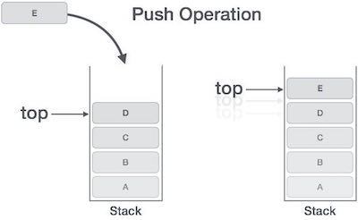
Push Operation

Slide 19
PUSH Operation Algorithm
PUSH(STACK, TOP, MAXSTK, ITEM)
This procedure pushes an ITEMS onto a stack.
1. [Stack already filled?]
IF TOP = MAXSTK, then:
Write : OVERFLOW
Return.
ENDIF
2. Set TOP: = TOP + 1 [Increase TOP by 1.]
3. Set STACK[TOP] := ITEM. [ Inserts ITEM in new TOP Position.]
4. Return.

Slide 20
Pop Operation
The process of deleting an element from stack is known as POP operation.
In order to delete an element from stack first we have to check weather stack is empty or not. If stack is empty then we can not delete an element from stack. This condition is known as “Underflow”.
If value of TOP variable is -1 then stack is empty. So we can not delete an element from stack.
If stack is not underflow then we can delete topmost element from stack. After deleting topmost element from stack, we have to decrement the value of TOP by one, so that it can point to the next topmost element in the stack.

Slide 21
Pop Operation
Accessing the content while removing it from the stack, is known as a Pop Operation.
In an array implementation of pop() operation, the data element is not actually removed, instead top is decremented to a lower position in the stack to point to the next value.
But in linked-list implementation, pop() actually removes data element and deallocates memory space.

Slide 22
Pop Operation simple Steps
A Pop operation may involve the following steps −
Step 1 − Checks if the stack is empty.
Step 2 − If the stack is empty, produces an error and exit.
Step 3 − If the stack is not empty, accesses the data element at which top is pointing.
Step 4 − Decreases the value of top by 1.
Step 5 − Returns success.

Slide 23
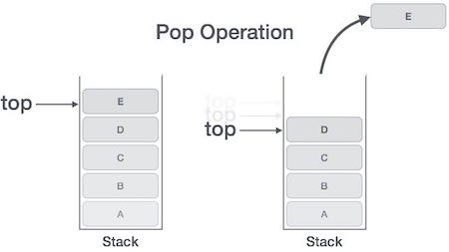
Pop Operation

Slide 24
POP Operation Algorithm
POP(STACK, TOP, ITEM)
This procedure deletes the top elements of STACK and assigns it to the variable ITEM.
1. [Stack has an items to be removed?]
IF TOP = 0, then:
Write: UNDERFLOW
Return
ENDIF
2. Set ITEM := STACK[TOP]. [Assigns TOP elements to ITEM.]
3. Set TOP := TOP - 1. [Decreases TOP elements to ITEM.]
4. Return.

Slide 25
Polish Notations
Infix notation
Prefix notation
Postfix notation
Algorithm for evaluation of postfix expression
Algorithm for converting the prefix notation into postfix notation

Slide 26
Polish Notations
The way to write arithmetic expression is known as a notation
There are basically three types of polish notation:
Infix: When the operator is written between two operands then it is known as Infix notation. For example A+B
Prefix: When the operator is written before their operands then it is known as Prefix notation. For example +AB
Postfix: When the operator is written after their operands then it is known as Postfix notation. For example AB+

Slide 27
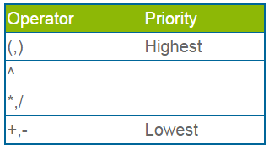
Polish Notations
Operator Precedence
Following are the precedence of each operator from highest to lowest.

Slide 28
Polish Notations
Conversion of Infix Expression into Postfix Expression
Generally we use infix notation in arithmetic expression.
In order to convert an expression from infix notation to postfix notation follows some steps

Slide 29
Polish Notations
Infix Expression into Postfix Expression steps
(1) Initialize an empty stack.
(2) Scan infix string from left to right.
(3) If scanned character is an operand then append it into postfix string.
(4) If scanned character is left parenthesis “(“then PUSH it into stack.
(5) If scanned character is an operator and stack is either empty or contains “(“at topmost element then PUSH it into stack.
(6) If scanned character is right parenthesis “)” then POP all the operators from stack until “(“is encountered in the stack. Do not append parenthesis into postfix string.

Slide 30
Polish Notations
Infix Expression into Postfix Expression steps
(7) If scanned character is an operator and top of the stack also contains an operator then we have to compare the precedence of operators as follow:
(a) If precedence of scanned operator is less then or equal to the precedence of topmost operator in the stack then POP that operator from stack and append it into postfix string and PUSH scanned operator into stack.
(b) If precedence of scanned operator is greater then the precedence of topmost operator in the stack then PUSH scanned operator into stack.
(8) Repeat step7 until “(“is encountered into stack or stack becomes empty.
(9) When all the characters are scanned from infix string, POP remaining characters from stack and append it into postfix string.

Slide 31
Conversion from Infix to Postfix Algorithm (simple steps)
Step1
Scan the Infix expression from left to right for tokens (Operators, Operands & Parentheses) and perform the steps 2 to 5 for each token in the Expression

Slide 32
Algorithm
Step2
If token is operand, Append it in postfix expression
Step3
If token is a left parentheses “(“, push it in stack.

Slide 33
Algorithm
Step4
If token is an operator,
Pop all the operators which are of higher or equal precedence then the incoming token and append them (in the same order) to the output Expression.
After popping out all such operators, push the new token on stack.

Slide 34
Algorithm
Step5
If “)” right parentheses is found,
Pop all the operators from the Stack and append them to Output String, till you encounter the Opening Parenthesis “(“.
Pop the left parenthesis but don’t append it to the output string (Postfix notation does not have brackets).

Slide 35
Algorithm
Step6
When all tokens of Infix expression have been scanned. Pop all the elements from the stack and append them to the Output String.
The Output string is the Corresponding Postfix Notation.

Slide 36
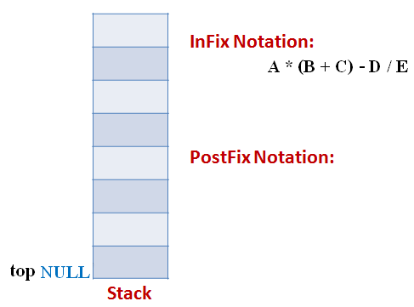
Example
Let the incoming the Infix expression be:
A * (B + C) – D / E
Stage 1: Stack is empty and we only have the Infix Expression.

Slide 37
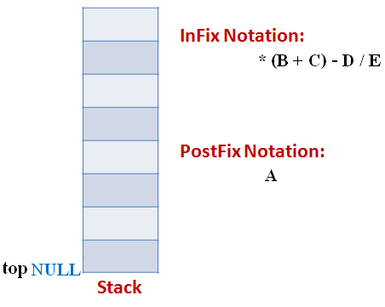
Example
Stage 2
The first token is Operand A Operands are Appended to the Output as it is.

Slide 38
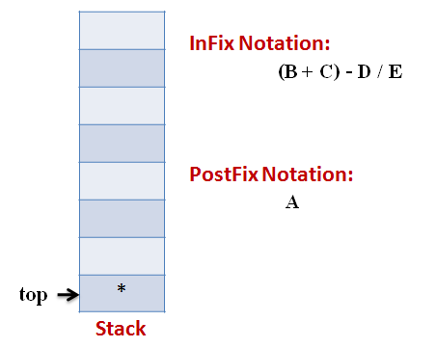
Example
Stage 3
Next token is * Since Stack is empty (top==NULL) it is pushed into the Stack

Slide 39
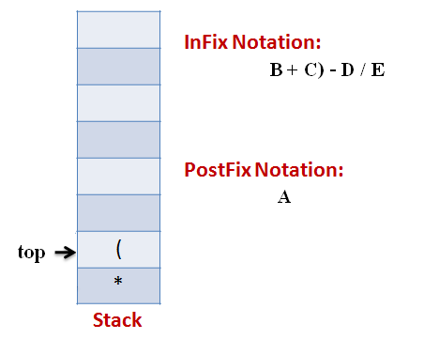
Example
Stage 4
Next token is ( the precedence of open-parenthesis, when it is to go inside, is maximum.
But when another operator is to come on the top of ‘(‘ then its precedence is least.

Slide 40
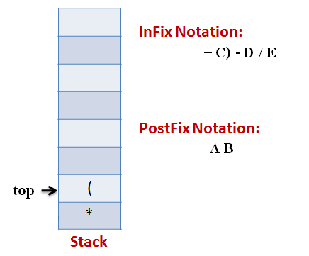
Example
Stage 5
Next token, B is an operand which will go to the Output expression as it is

Slide 41
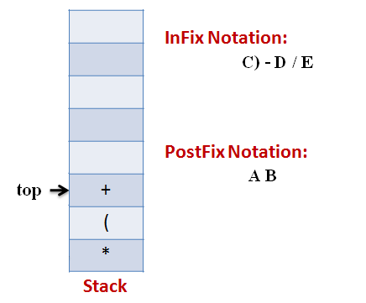
Example
Stage 6
Next token, + is operator, We consider the precedence of top element in the Stack, ‘(‘. The outgoing precedence of open parenthesis is the least (refer point 4. Above). So + gets pushed into the Stack

Slide 42
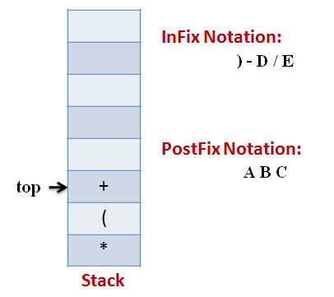
Example
Stage 7
Next token, C, is appended to the output

Slide 43
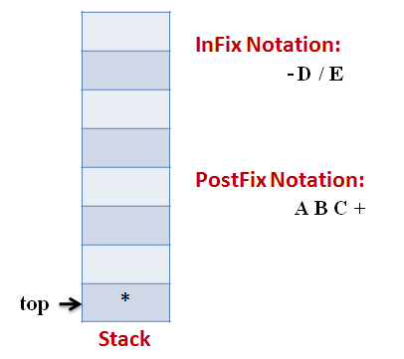
Example
Stage 8
Next token ), means that pop all the elements from Stack and append them to the output expression till we read an opening parenthesis.

Slide 44
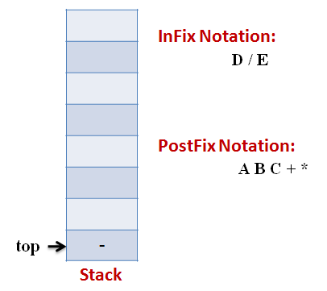
Example
Stage 9
Next token, -, is an operator. The precedence of operator on the top of Stack ‘*‘ is more than that of Minus. So we pop multiply and append it to output expression. Then push minus in the Stack.

Slide 45
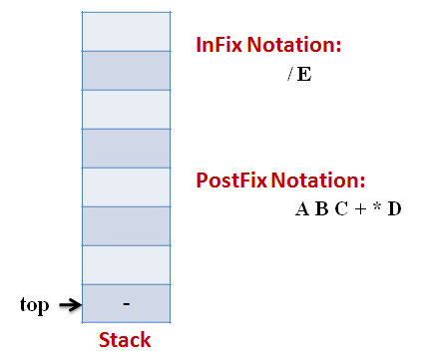
Example
Stage 10
Next, Operand ‘D‘ gets appended to the output.

Slide 46
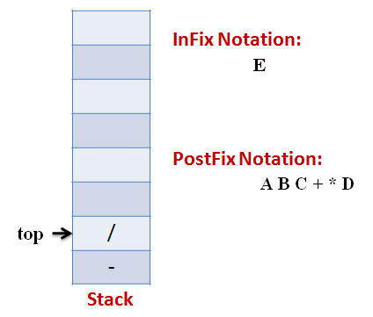
Example
Stage 11
Next, we will insert the division operator into the Stack because its precedence is more than that of minus.

Slide 47
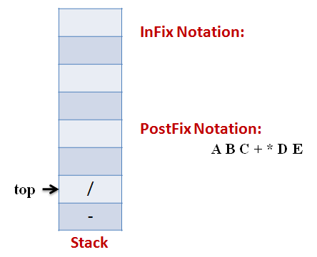
Example
Stage 12
The last token, E, is an operand, so we insert it to the output Expression as it is.

Slide 48
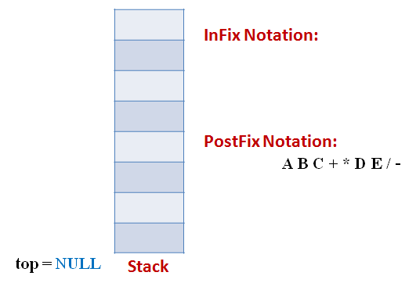
Example
Stage 13
The input Expression is complete now. So we pop the Stack and Append it to the Output Expression as we pop it.

Slide 49
Algorithmic Steps for Infix to Postfix
1) Examine the next element in the input.
2) If it is operand, output it.
3) If it is opening parenthesis, push it on stack.
4) If it is an operator, then
i) If stack is empty, push operator on stack.
ii) If the top of stack is opening parenthesis, push operator on stack
iii) If it has higher priority than the top of stack, push operator on stack.
iv) Else pop the operator from the stack and output it, push scanned character repeat step 4
5) If it is a closing parenthesis, pop operators from stack and output them until an opening parenthesis is encountered. pop and discard the opening parenthesis.
6) If there is more input go to step 1
7) If there is no more input, pop the remaining operators to output.
Notes:
Mean

Slide 50
Algorithm for Converting Infix Expression into Postfix Expression
POLISH(Q,P)
Suppose Q is an arithmetic expression written in infix notation. This algorithm finds the equivalent postfix expression P.
1) Scan Q from left to right and repeat Steps 2 to 5 for each elements of Q until the STACK is empty:
2) If an operand is encountered, add it to P.
3) If a left parenthesis is encountered. Push it onto STACK.
4) If an operator × is encountered, then:
a) Repeatedly pop from STACK and add to P each operator (on the top of STACK) which has the same precedence as or higher precedence than ×.
b) Add × to STACK.
[End of If Structure.]
5) If a right parenthesis is encountered, then:
a) Repeatedly pop from STACK and add to P each operator (on the top of STACK) until a left parenthesis is encountered:
b) Remove the left parenthesis. [Do not add the left parenthesis to P.]
[End of If Structure.]
[End of Step loop.]
6) Exit.

Slide 51
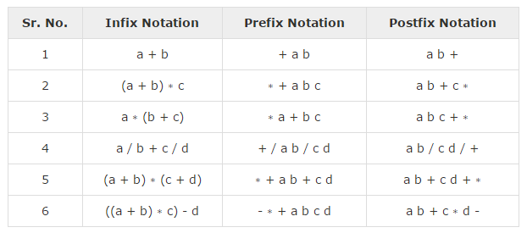
Evaluation diff: b/w Infix, Prefix n postfix

Slide 52
Infix to Postfix Example
Infix String: (a + b) * (c + d)
Scanned Character | Content of Stack | Postfix String
 | Empty | Empty
( | ( | Empty
a | ( | a
+ | (+ | a
b | (+ | ab
) | Empty | ab+
* | * | ab+
( | *( | ab+
c | *( | ab+c
+ | *(+ | ab+c
d | *(+ | ab+cd
) | * | ab+cd+
 |  | ab+cd+*

Slide 53
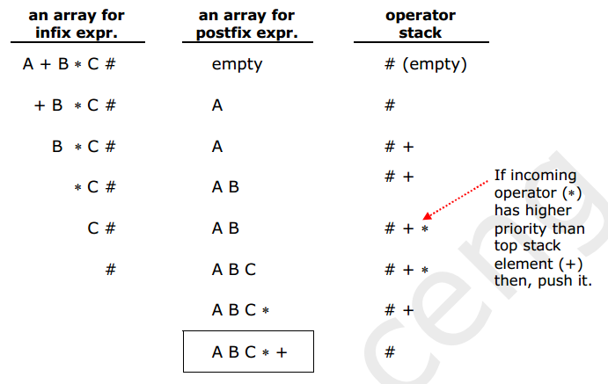
Infix to Postfix Conversion(Examples)

Slide 54
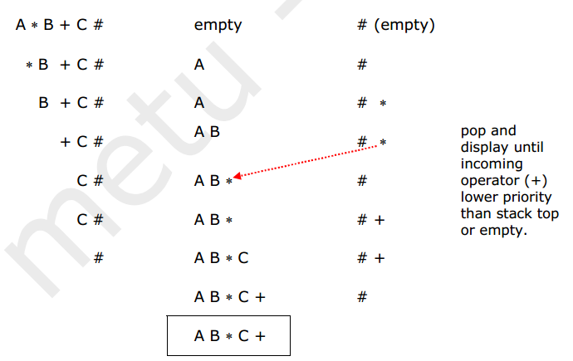
Infix to Postfix Conversion(Examples)

Slide 55
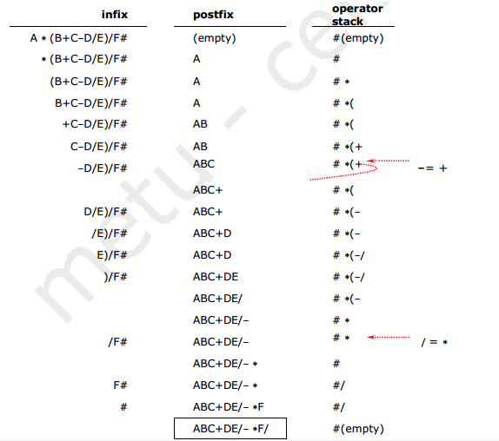
Infix to Postfix Conversion(Examples)

Slide 56
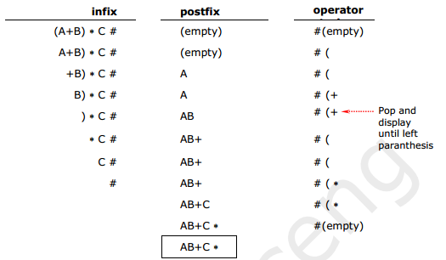
Infix to Postfix Conversion(Examples)

Slide 57
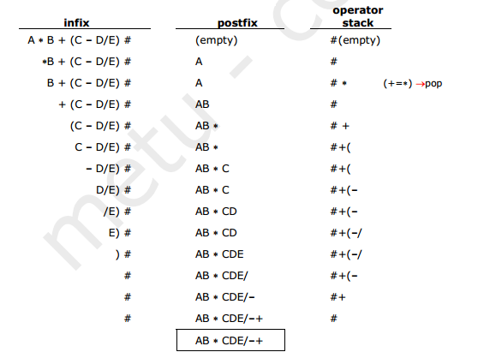
Infix to Postfix Conversion(Examples)

Slide 58

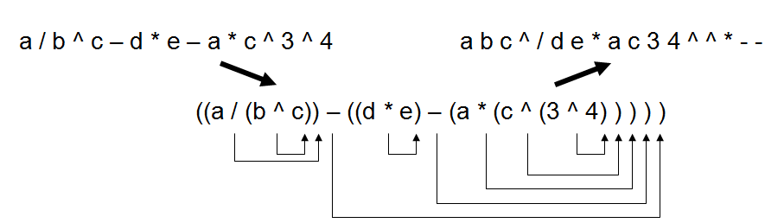
Infix to Postfix
An Infix to Postfix manual conversion algorithm is:
1. Completely parenthesize the infix expression according to order of priority you want.
2. Move each operator to its corresponding right parenthesis.
Remove all parentheses.
Example

Slide 59

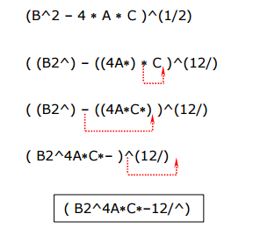
Infix TO Postfix Example (Without open stack-manual)

Slide 60
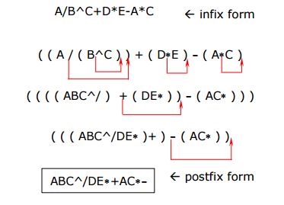
Infix TO Postfix Example (Without open stack-manual)

